Slide 1


Digital Sales Aid for Windows
Salesforce Cloud Services – Sales LoB Offering
Arvind Mukhi, Solution Architect
Vaibhav Joshi, Solution Architect

Slide 2
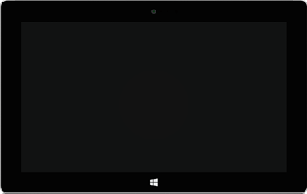

Digital Sales Aid (DSA) for Windows!
Salesforce Cloud Services Digital Sales Aid now available for Windows operating system.

Slide 3
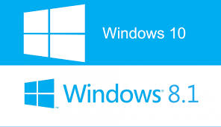
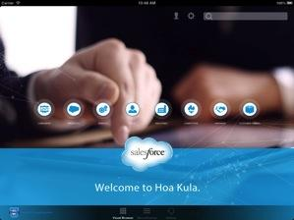
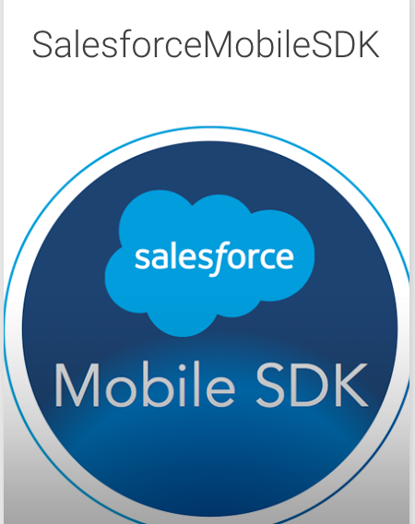
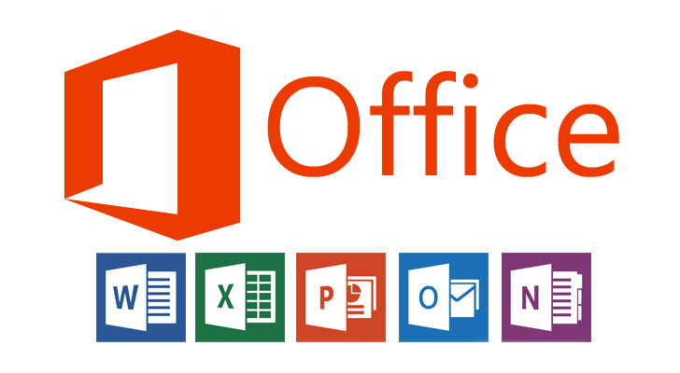
Benefits
Supported on Windows 8 and 10
Windows based devices supported
Built on Salesforce Mobile SDK for Windows
Features in-par with the other DSA native apps
Utilize Microsoft Office for accurate presentation of the content

Slide 4
Feature Set Comparison
 | iOS | Android | Windows 8/10
Tablet | X | X | X
Desktop
Offline | X | X | X
Interactive Content (HTML5 Bundle) | X | X | X
Utilizes External Content Viewer Tools |  | X | X
Playlists | X |  | X
Tracking | X | X | X
Check-In | X | X | X
Like / Dislike Content | X (Rating) | X (Rating) | X (Rating)
Branded | X | X | X

Slide 5
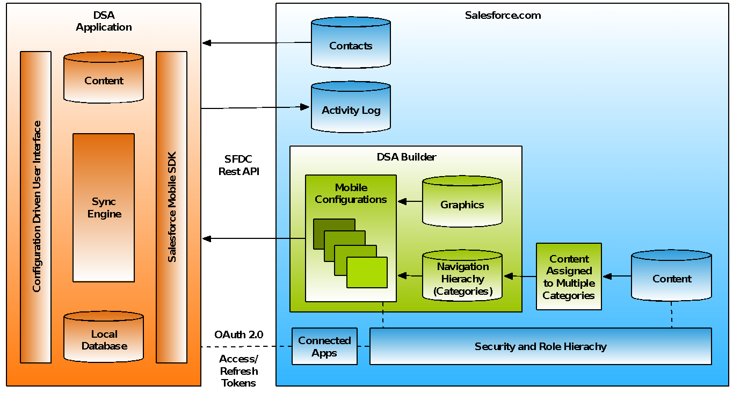
DSA Platform Architecture

Slide 6
Windows Environment
Supported Operating Systems
Windows 8.1
Windows 10
Supported Devices
Microsoft Surface 3 and Surface Pro with at least 2GB RAM
Lenovo Yoga with at least 2GB RAM

Slide 7
Image resolutions
Background Images
Landscape: 2160 x 1440
Portrait: 1440 x 2160
App Icons
30 x 30 px
50 x 50 px
120 x 120 px
150 x 150 px
210 x 210 px
270 x 270 px
Splash Screen
1116 x 540 px
868 x 420 px
620 x 300 px

Slide 8
Installation Instructions
Download and unzip App Package
Windows DSA Installation Package
Execute PowerShell Script
Open unzipped DSA folder.
Find ‘Add-AppDevPackage.ps1’ PowerShell Script file.
Right click on the file, and click on 'Run with PowerShell’.
PowerShell console window
If script asks 'Do you want to change the execution policy?' Enter 'y'.
Microsoft Developer Certificate
You might get prompted to download the Developer Certificate if you don't already have it on your Windows device. See https://msdn.microsoft.com/en-us/library/windows/apps/hh974578.aspx

Slide 9
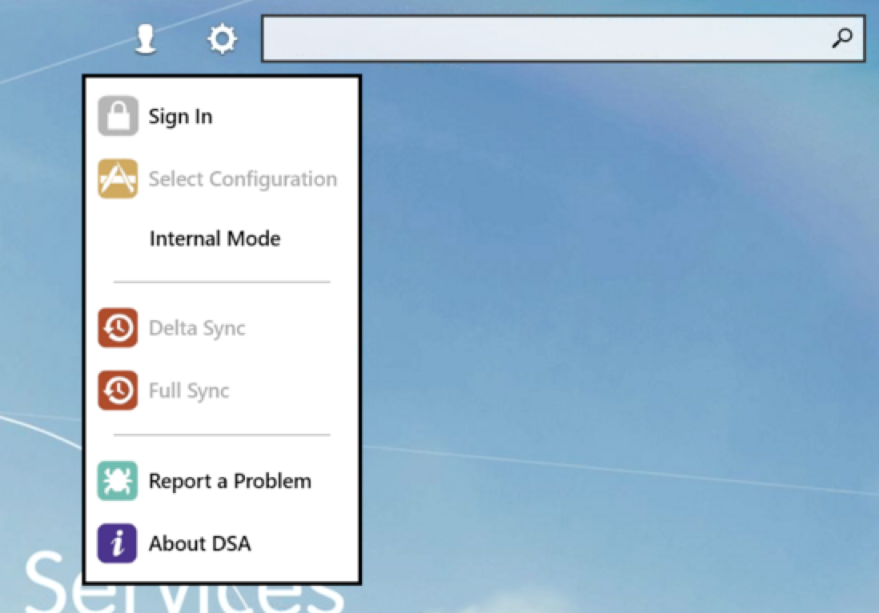

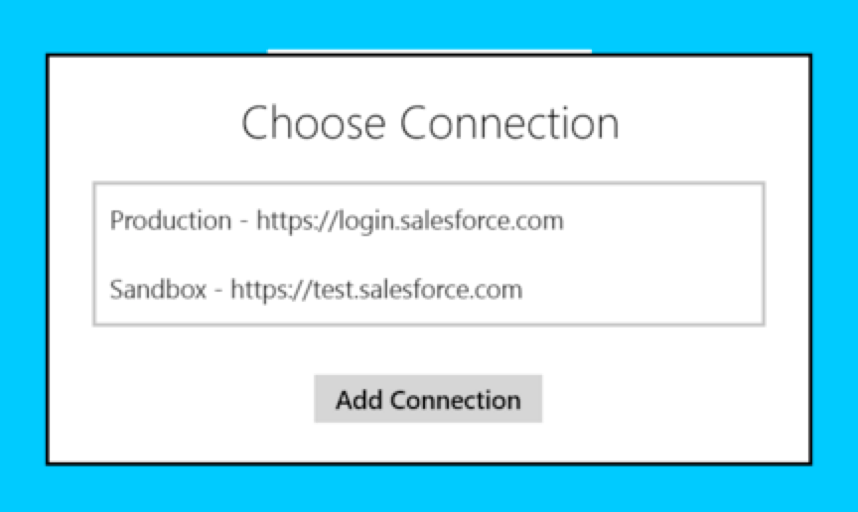
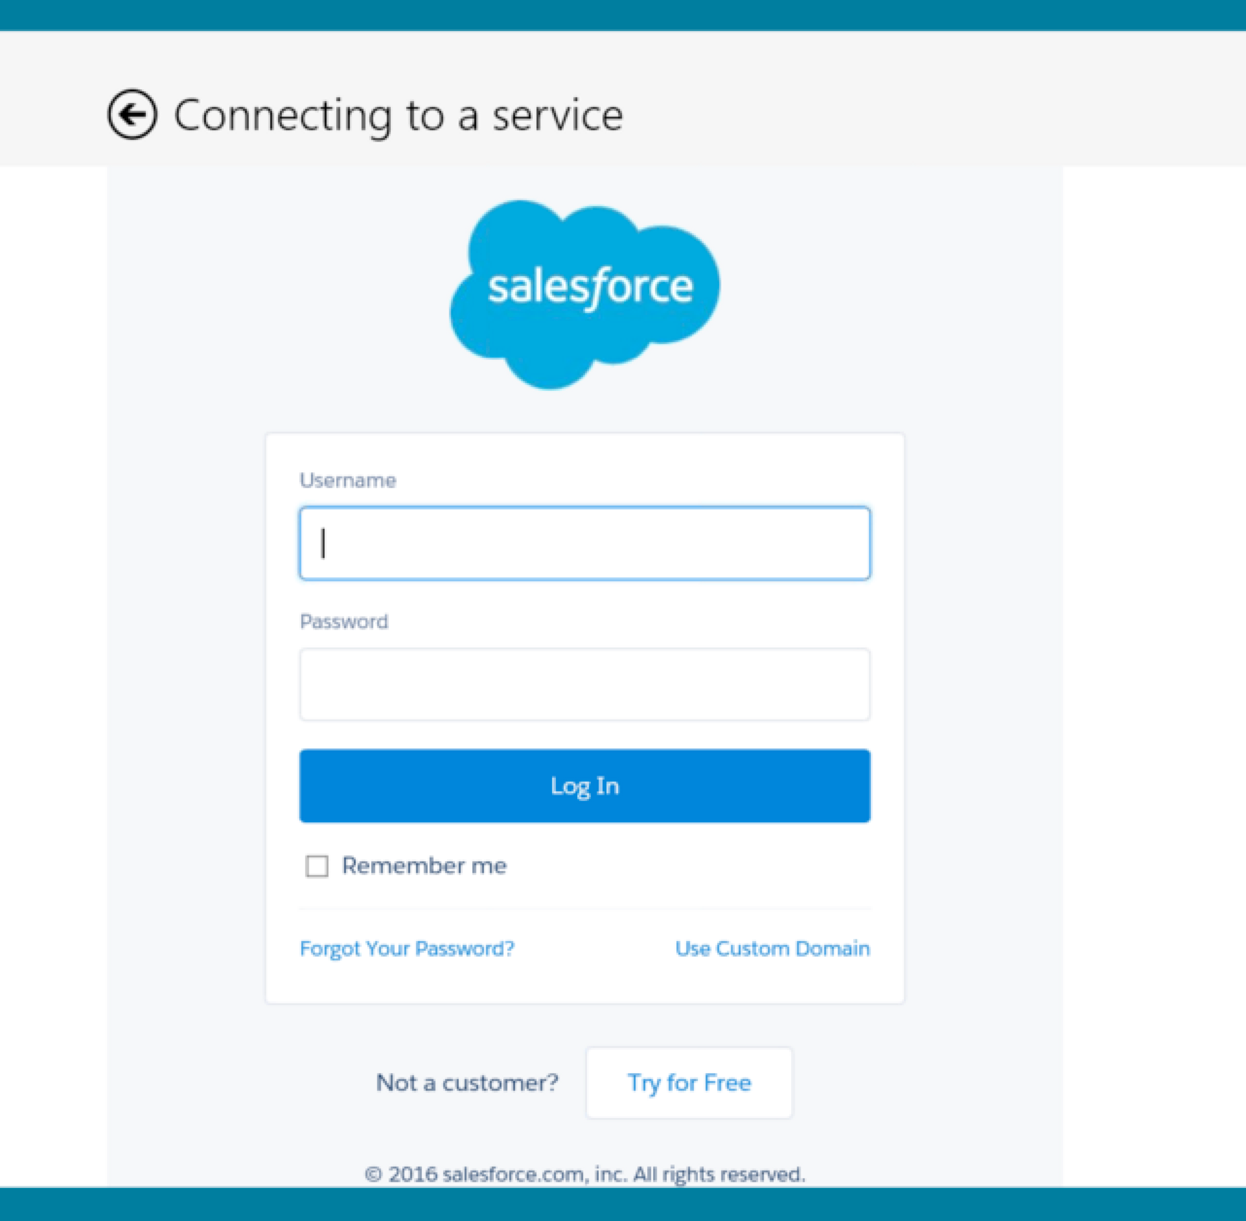
Login Instructions
Settings > Sign In
Choose Connection
Log In

Slide 10
Development Environment
Windows 8.1 or 10 operating system
Visual Studio 2015
SQLite SDK Extension Version 3.11.1
Microsoft .NET Framework 3.5
https://msdn.microsoft.com/en-us/library/cc160716(v=vs.90).aspx

Slide 11
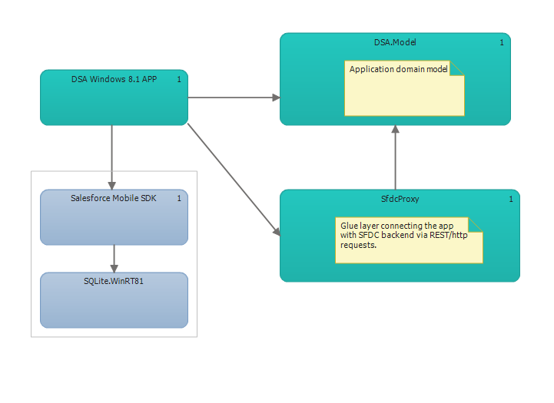
Architecture – logical layer diagram
MVVM architectural pattern
Salesforce Mobile SDK for Windows RT
SQLite with SmartStore

Slide 12
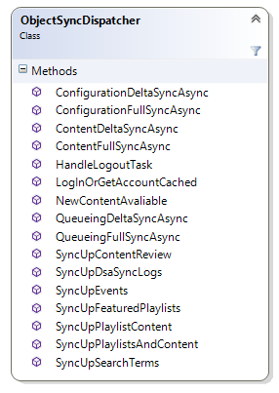
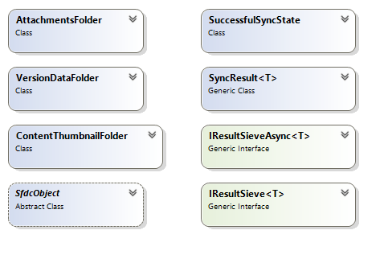
Core Class Structure

Slide 13
Re-sign the app using SignTool
Execute each line below at command prompt with Elevated Admin privileges (search for cmd and run as admin)
Unpack the package
MakeAppx unpack /l /p DSA.appx /d <TheAppDirectory>
Apply new Certificate
Edit Publisher Name in Manifest file <TheAppDirectory>/AppxManifest.xml
<Identity Name="CodeOne.SfdcDSA" Publisher="CN=46358290-73E0-45F4-B126-F557FE90B746" Version=<App Version> ProcessorArchitecture="x86" />
Re-package the app
MakeAppx pack /l /d TheApp /p <TheApp.appx>
Re-sign the app
SignTool sign /fd SHA256 /a /f TheKey.pfx <TheApp.appx>
Reference: MSDN article on how to sign an app package using SignTool
https://msdn.microsoft.com/en-us/library/windows/desktop/jj835835(v=vs.85).aspx

Slide 14
References
Windows Store App Deployment in an Enterprise
https://www.youtube.com/watch?v=pAkjpyST2zY
Packaging, deployment, and query of Windows Store apps
https://msdn.microsoft.com/en-us/library/windows/desktop/hh446593(v=vs.85).aspx
Manage the certificates that Visual Studio uses to sign your app
https://msdn.microsoft.com/en-us/library/br230260.aspx#Generate
Get a developer license
https://msdn.microsoft.com/en-us/library/windows/apps/hh974578.aspx
SSO with Windows Store Apps
https://msdn.microsoft.com/en-us/windows/uwp/security/web-authentication-broker
Developing Offline Mobile Apps with the Salesforce.com Mobile SDK SmartStore and SmartSync
http://gersic.com/developing-offline-mobile-apps-with-the-salesforce-com-mobile-sdk-smartstore-and-smartsync/

